Slide 1
STATISTICAL REVIEW
2019 - 2023
ONTARIO CONFERENCE EXECUTIVE SECRETARY’S REPORT

Slide 2
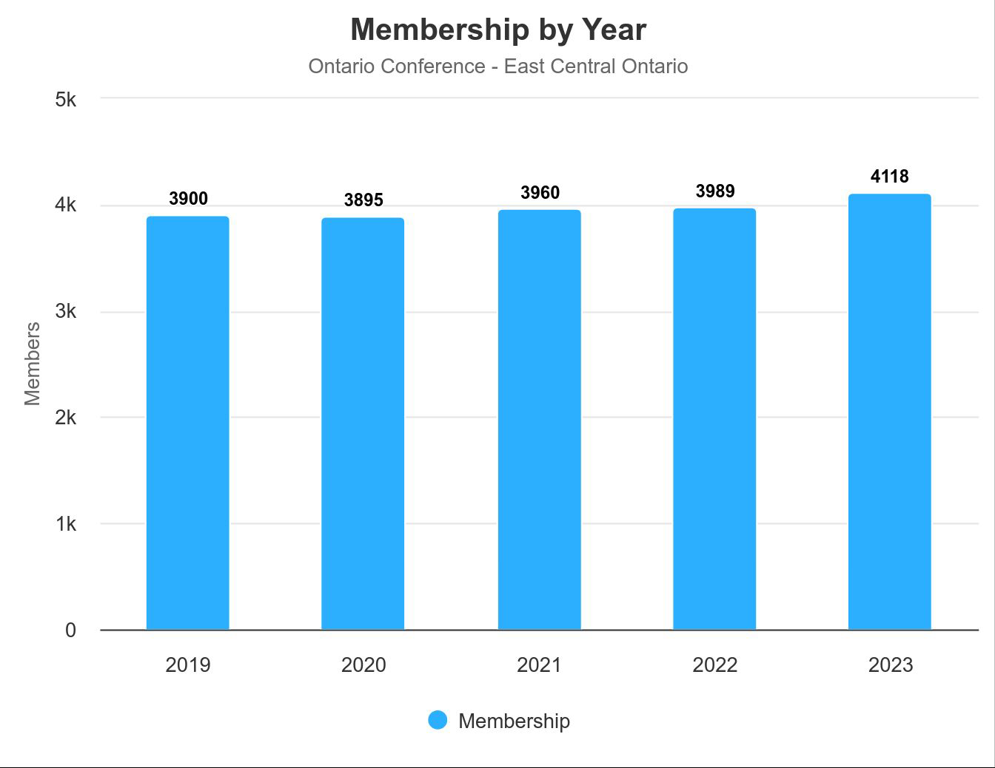
East Central

Slide 3
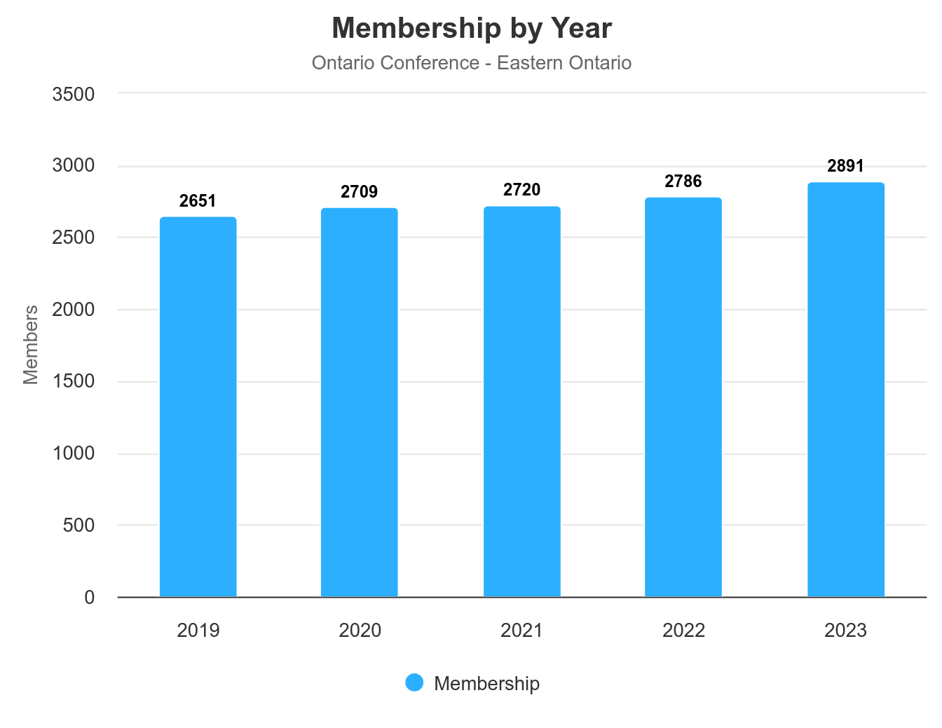
Eastern Ontario

Slide 4
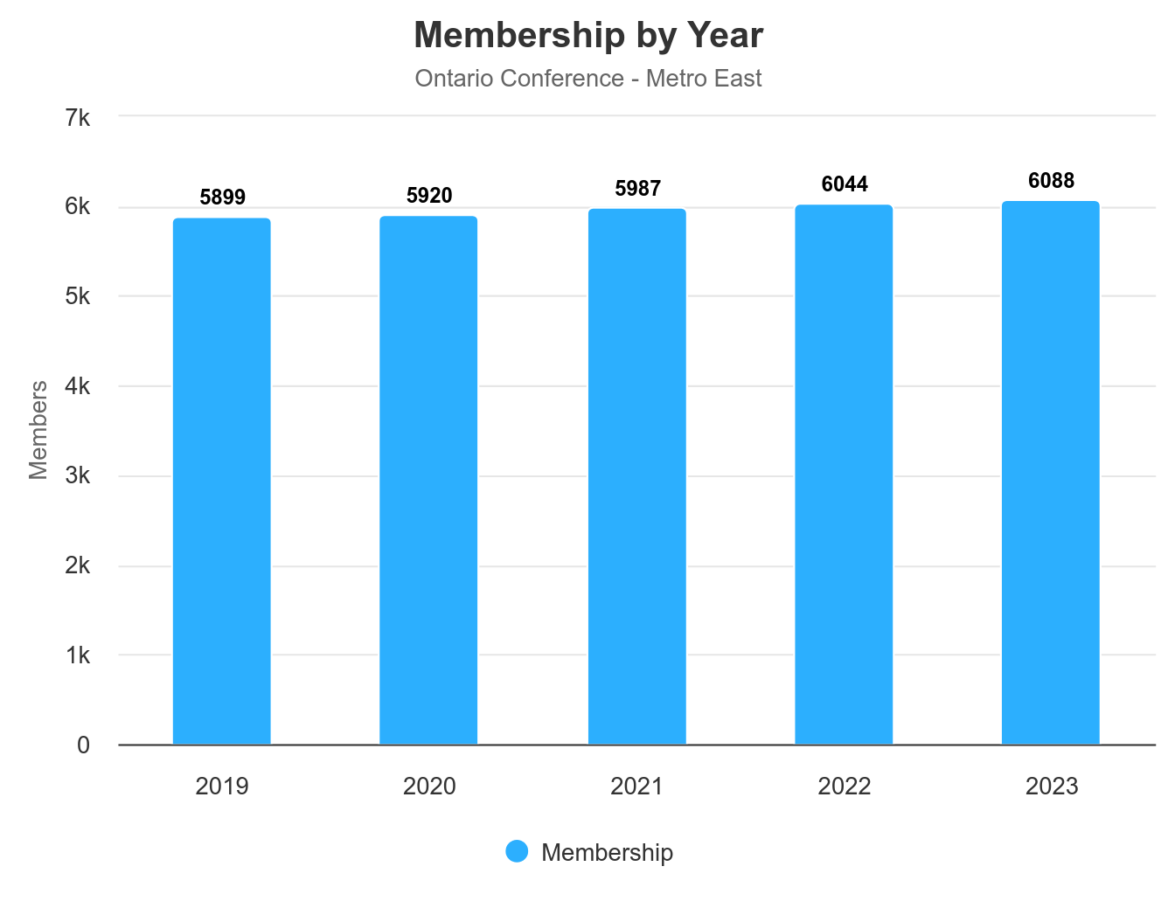
Metro East

Slide 5
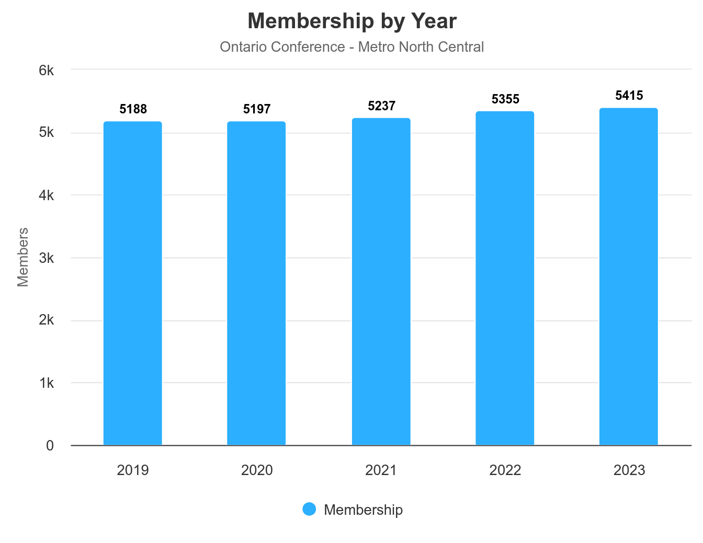
Metro North Central

Slide 6
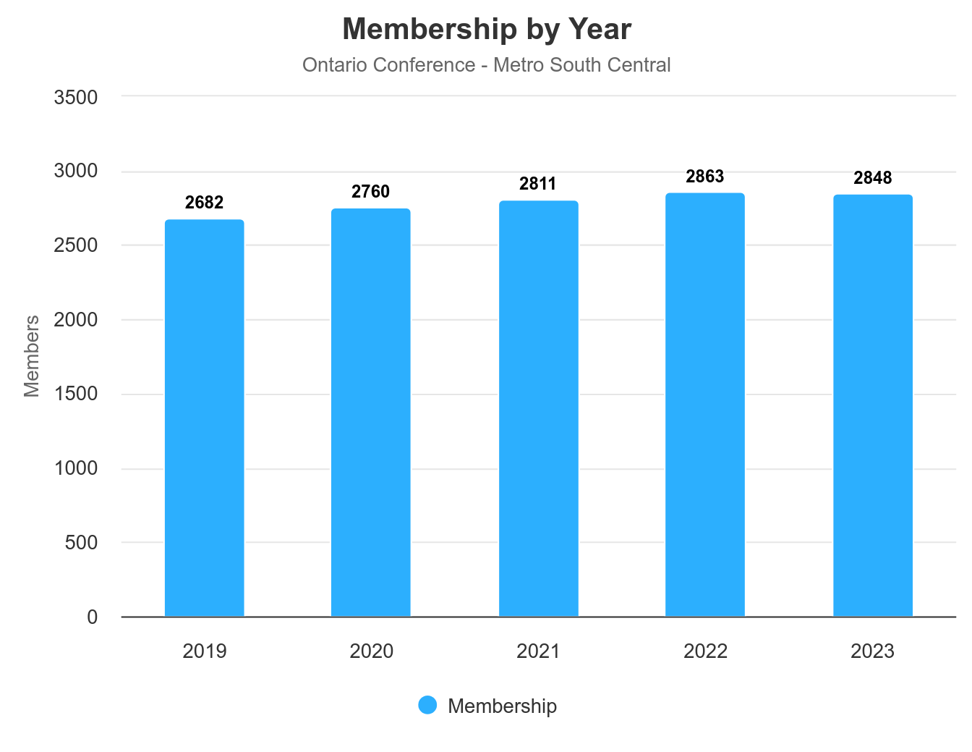
Metro South Central

Slide 7
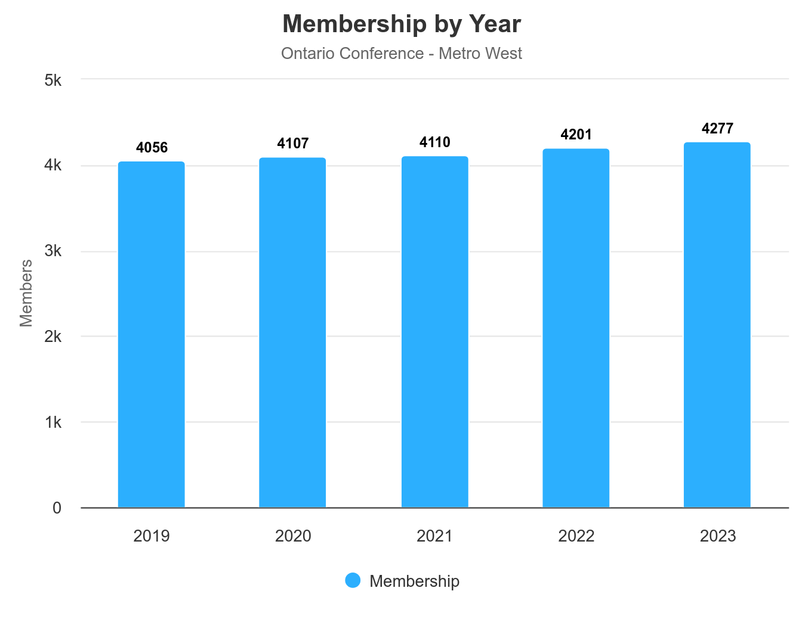
Metro West

Slide 8
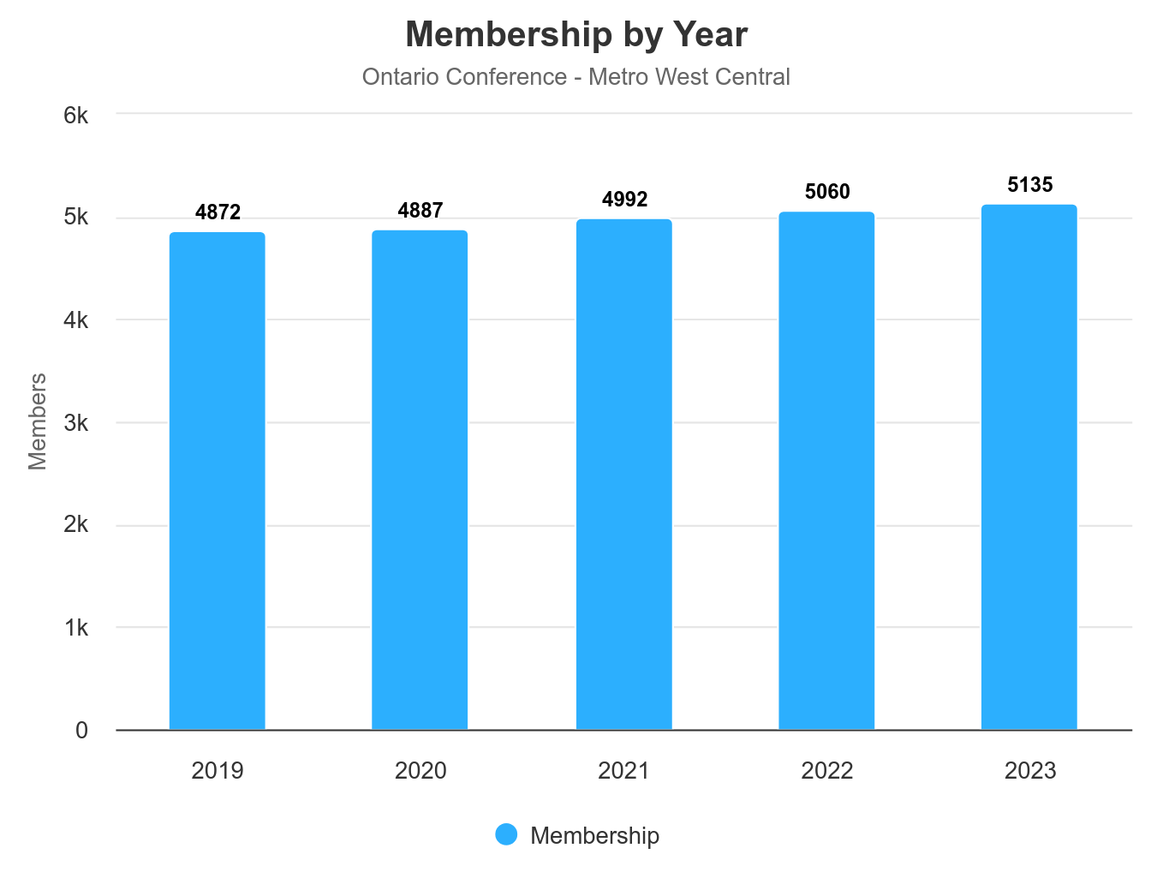
Metro West Central

Slide 9
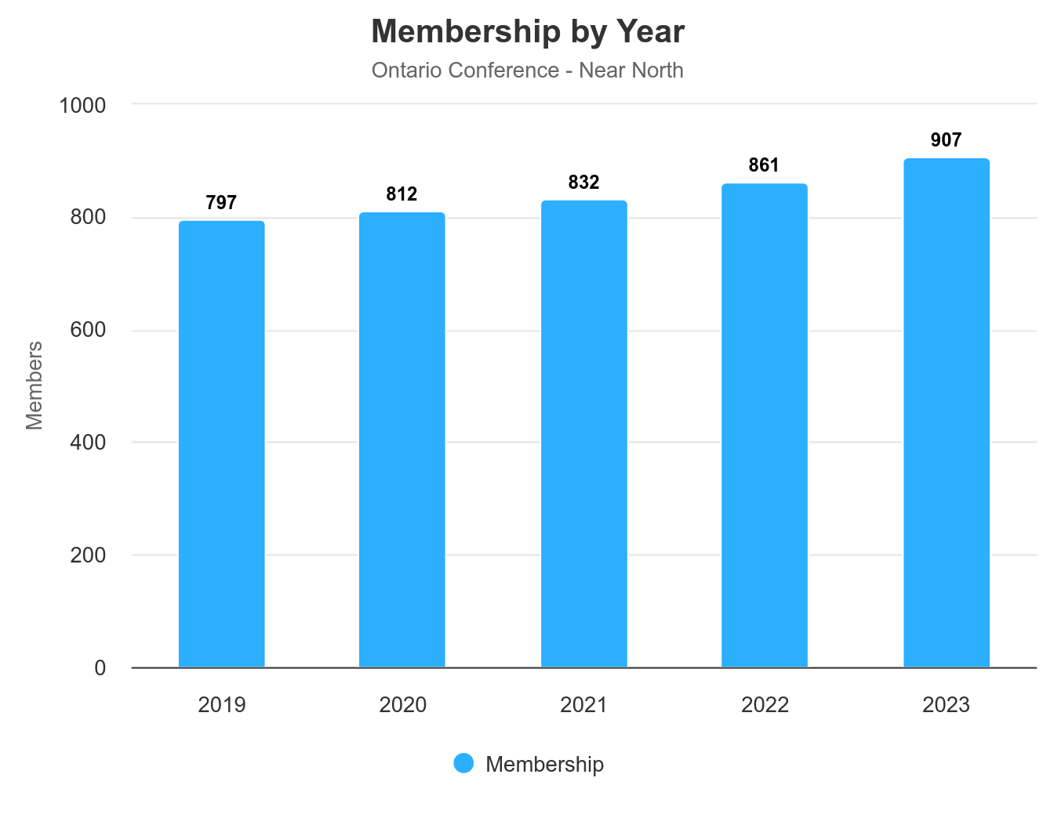
Near North

Slide 10
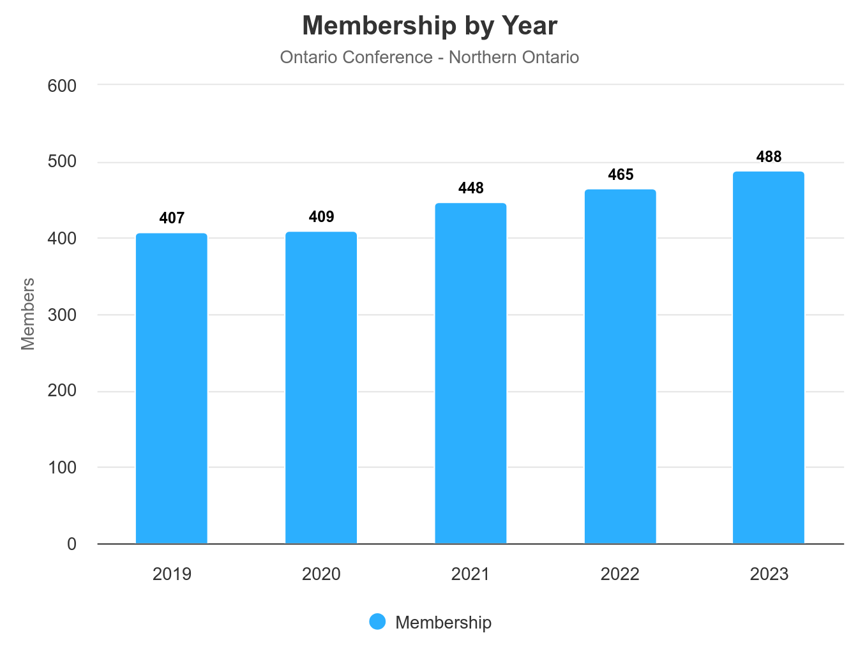
Northern Ontario

Slide 11
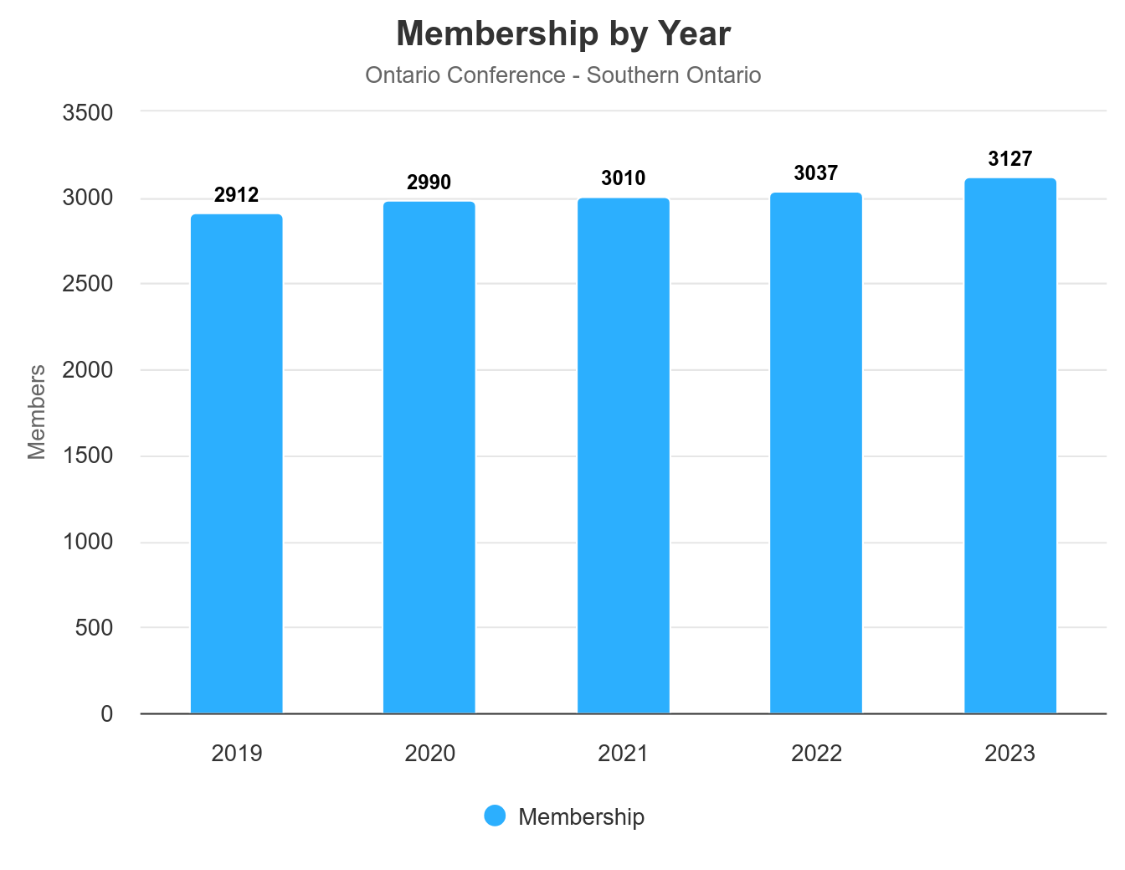
Southern Ontario

Slide 12
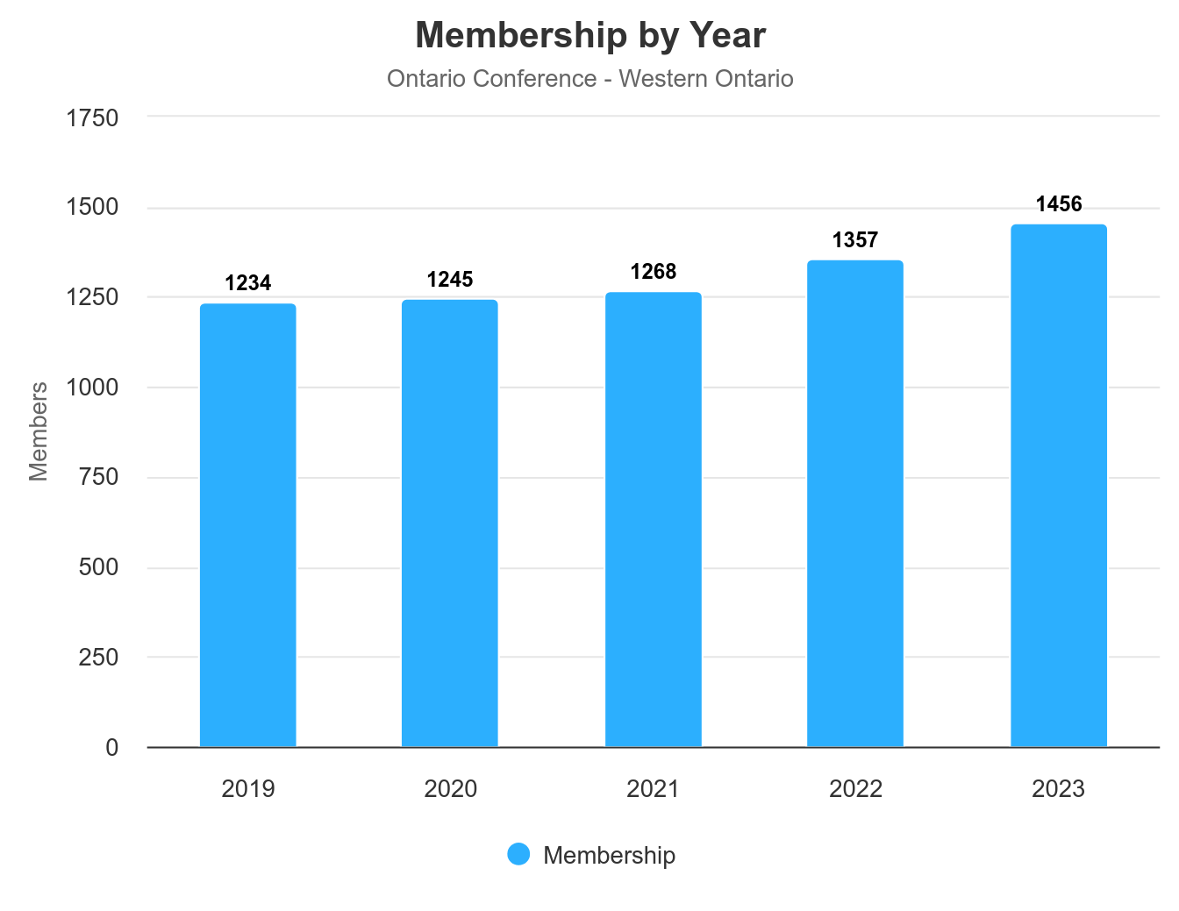
Western Ontario

Slide 13
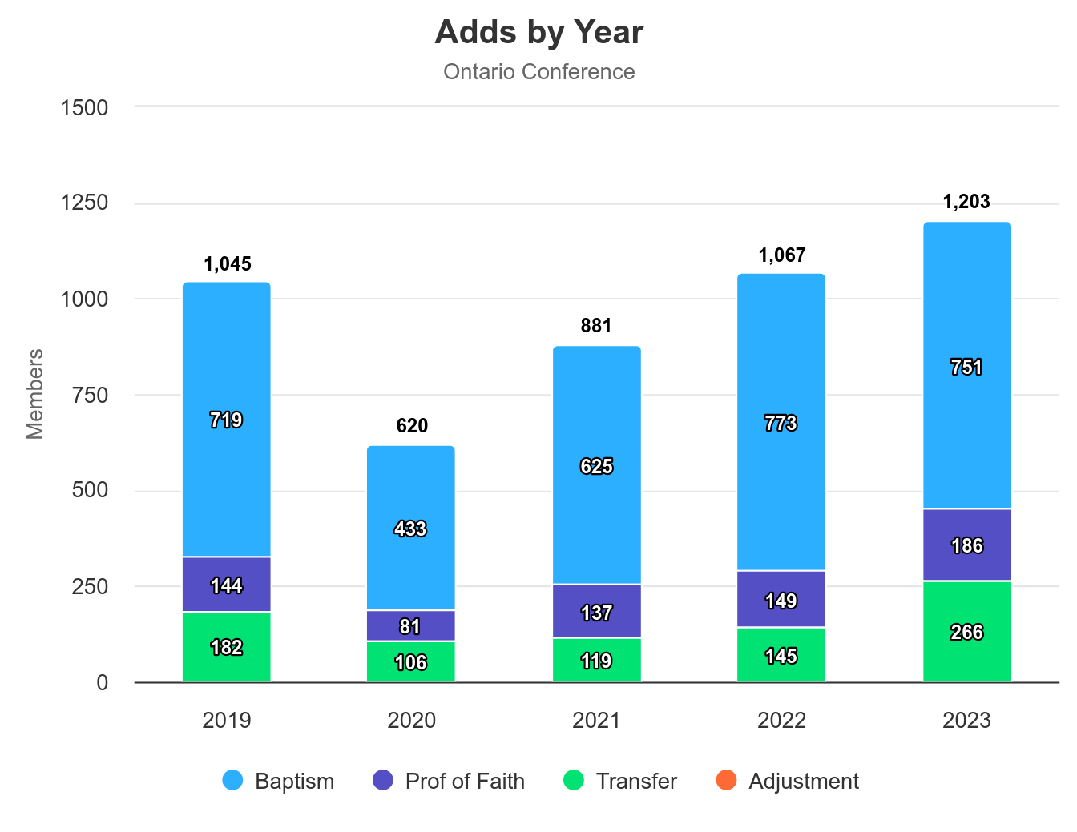
CONFERENCE WIDE FIVE YEARS INCREASE

Slide 14
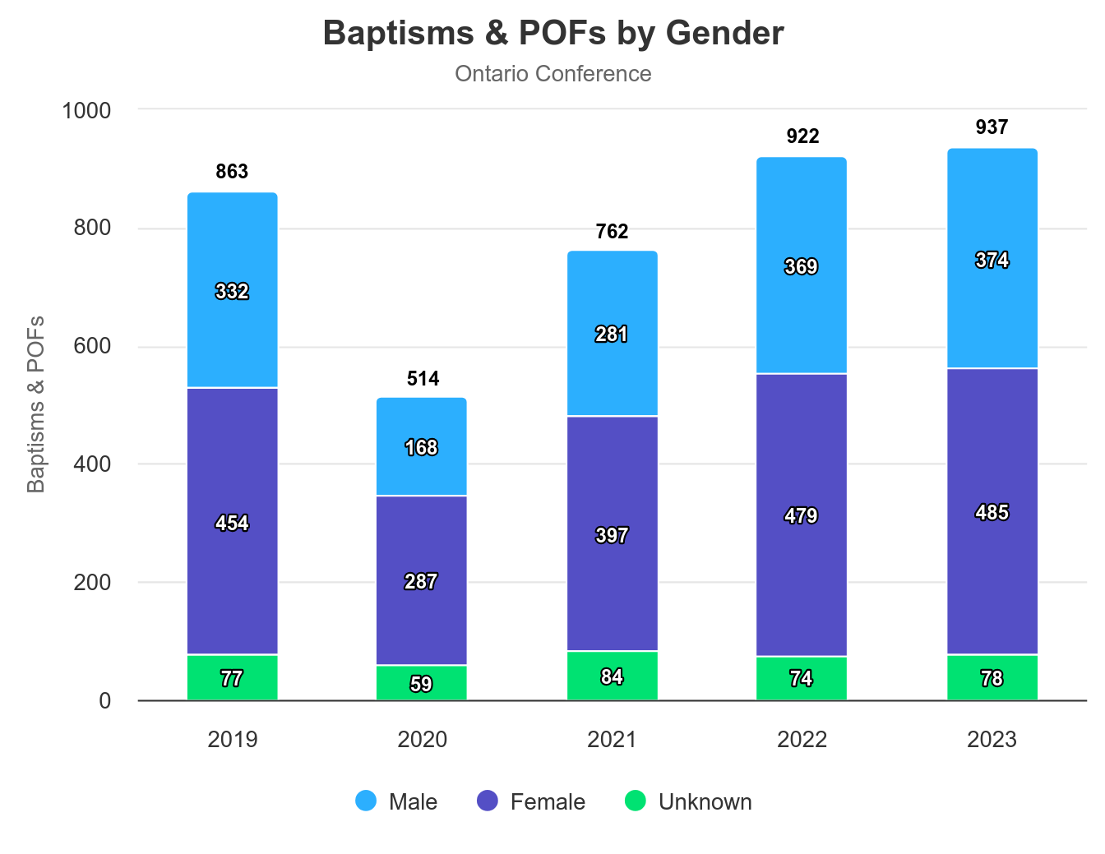
CONFERENCE WIDE BAPTISM AND POF BY GENDER

Slide 15
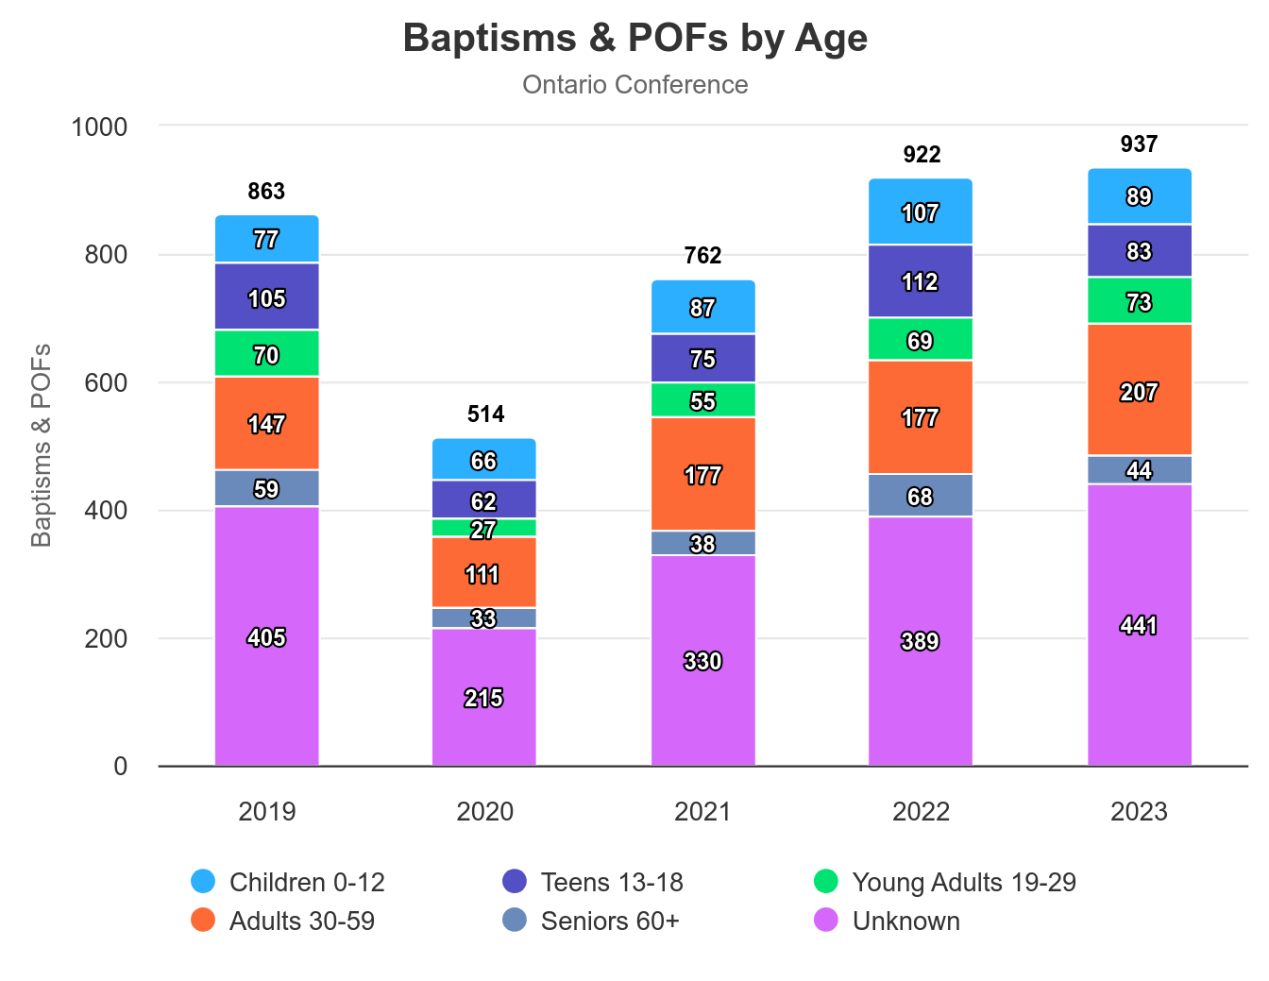
CONFERENCE WIDE BAPTISM AND POF BY AGE

Slide 16
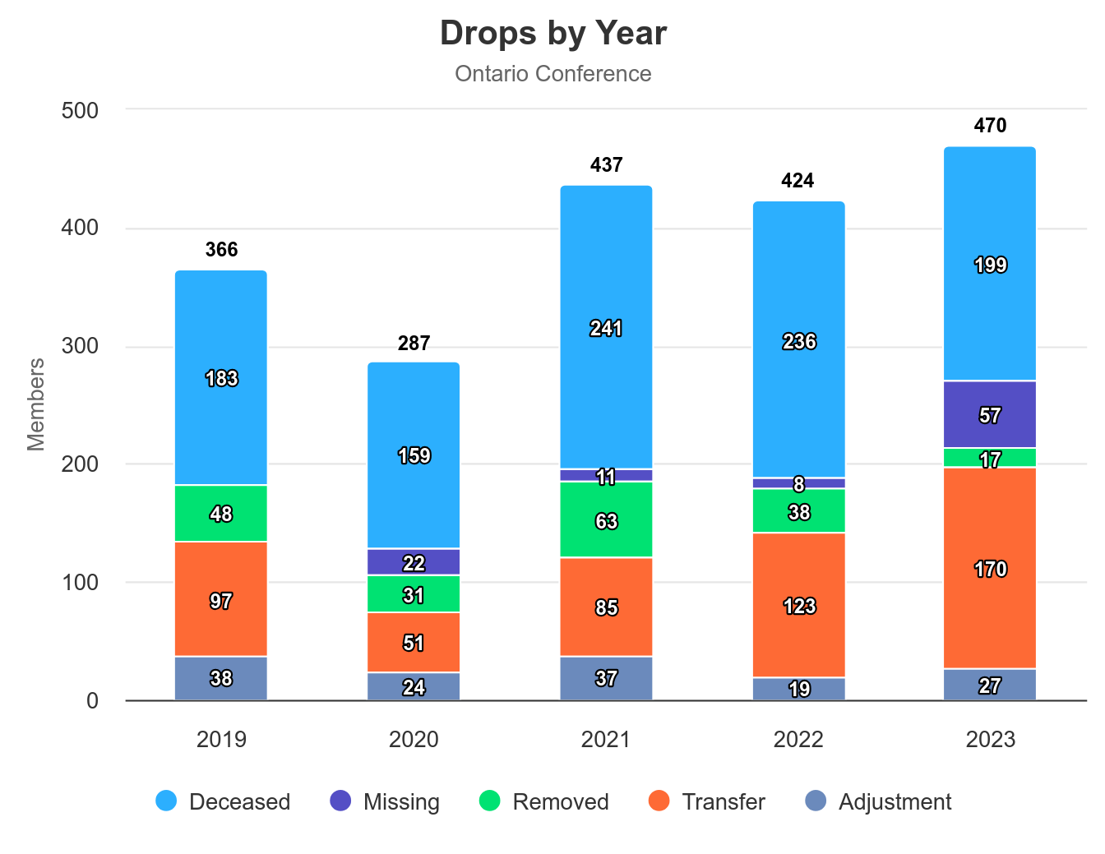
CONFERENCE WIDE DROPS

Slide 17
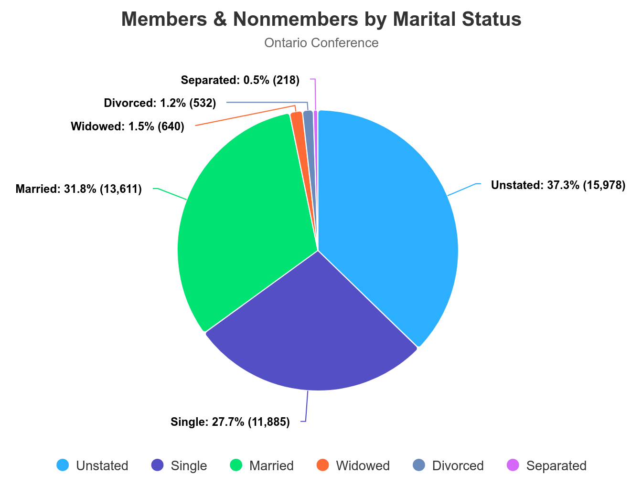
CONFERENCE WIDE MEMBERSHIP MARITAL STATUS

Slide 18
ACKNOWLEDGEMENT
I would like to thank all Church Clerks for their faithful, commitment and their hard work in updating their church membership status on eAdventist (Baptisms, PoF, Transfers, Deaths…) which facilitates the statistical report of the Conference Executive Secretary.
I pray that God will reward them for their faithfulness and their efforts.

